Slide 1

Bachelor of science in Mathematics
Department of Mathematics
Sacred Hearts and Science college
Perani
Affiliated to Annamalai University
Chidambaram-608002.
October, 2023

Slide 2
Subscribers Galore Exploring World‘s Top YouTube Channels
Submitted by
M.Bhuvaneswari 22421201002
K.Gayathri 22421201005
K. Kalaivani 22421201007
J. Mahalakshmi 22421201008
A. Girija shalini 22421201006
GUIDED BY
Mrs. k. RADHA

Slide 3
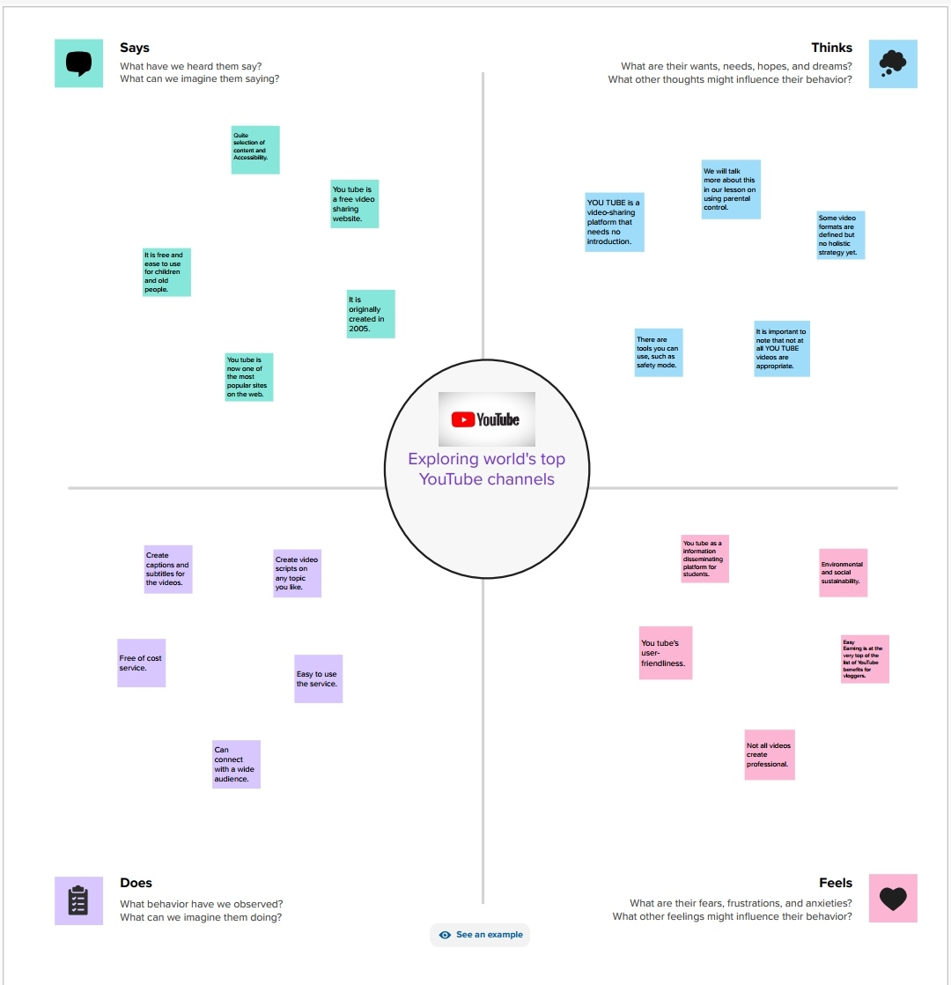

Slide 4
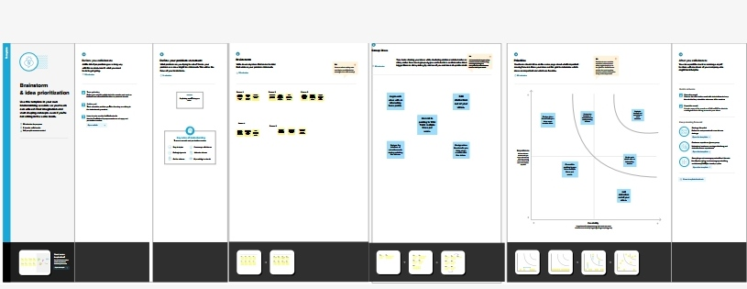

Slide 5
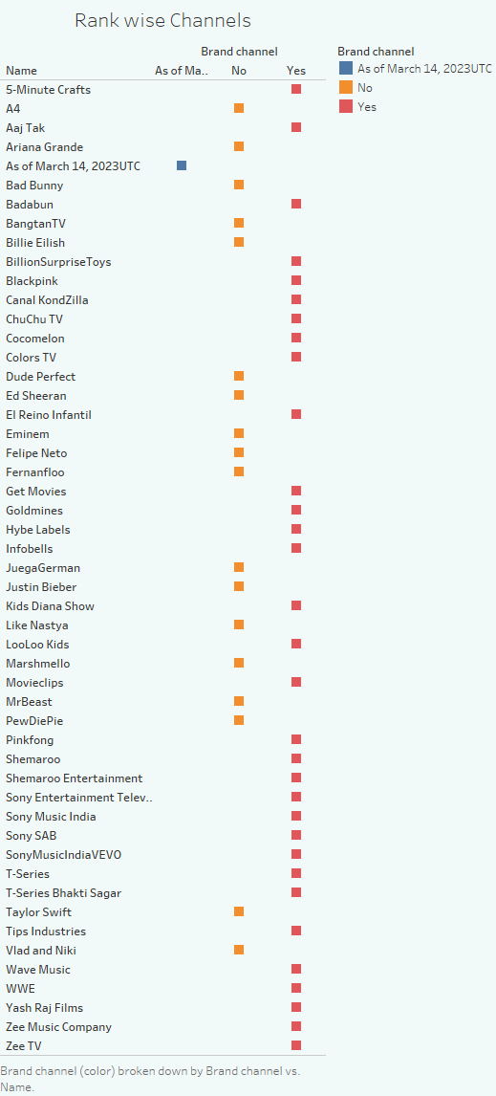

Slide 6
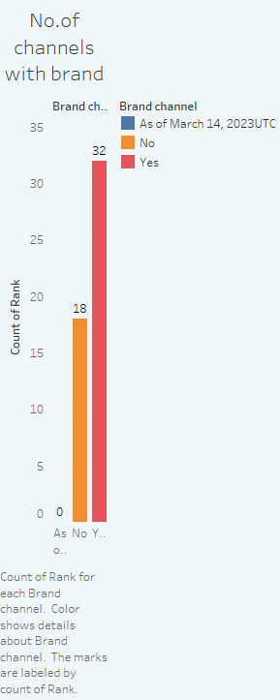

Slide 7


Slide 8
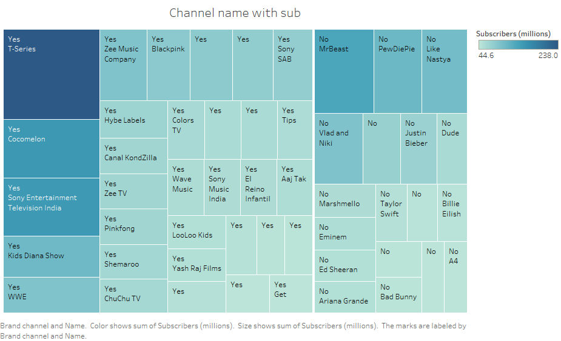

Slide 9
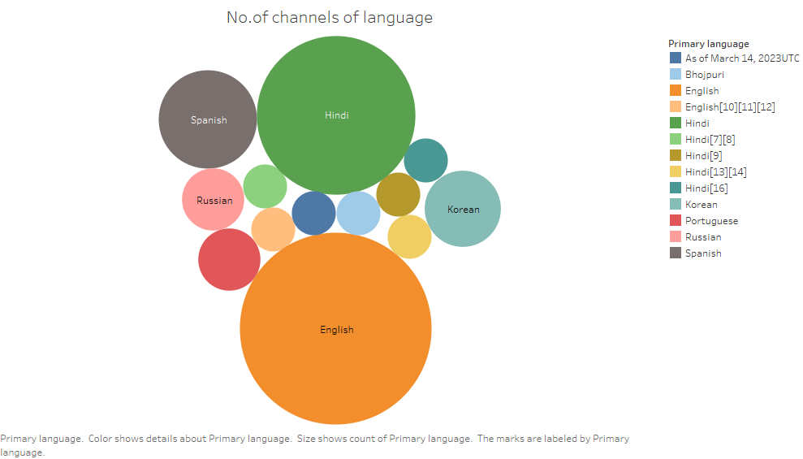

Slide 10
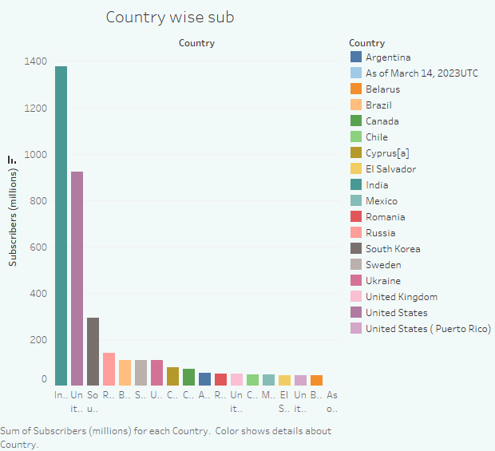

Slide 11
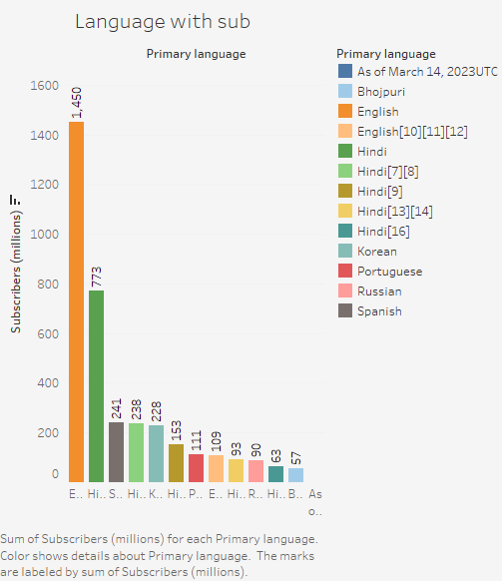

Slide 12
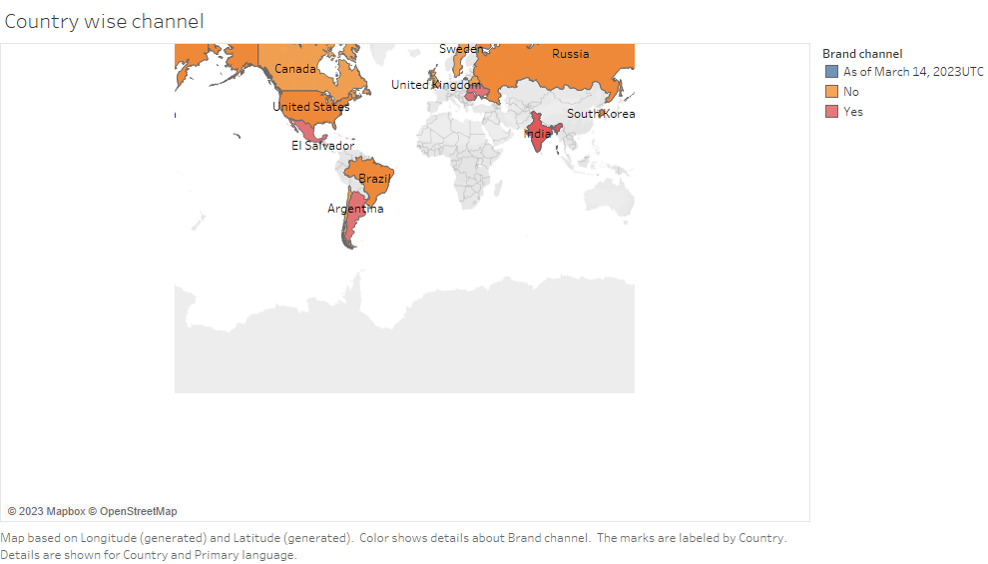

Slide 13
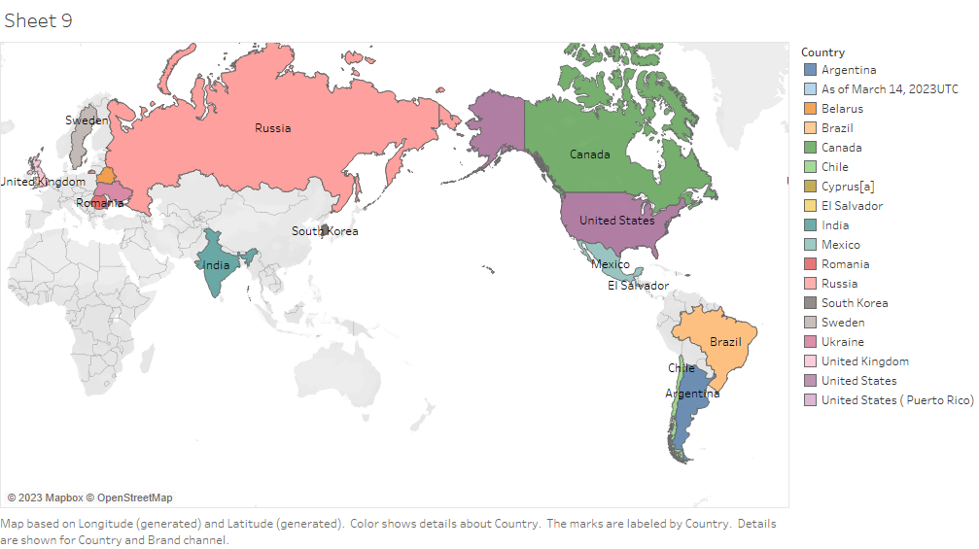

Slide 14
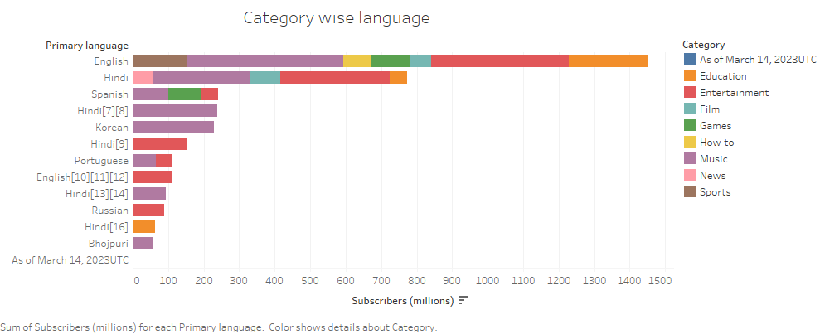

Slide 15
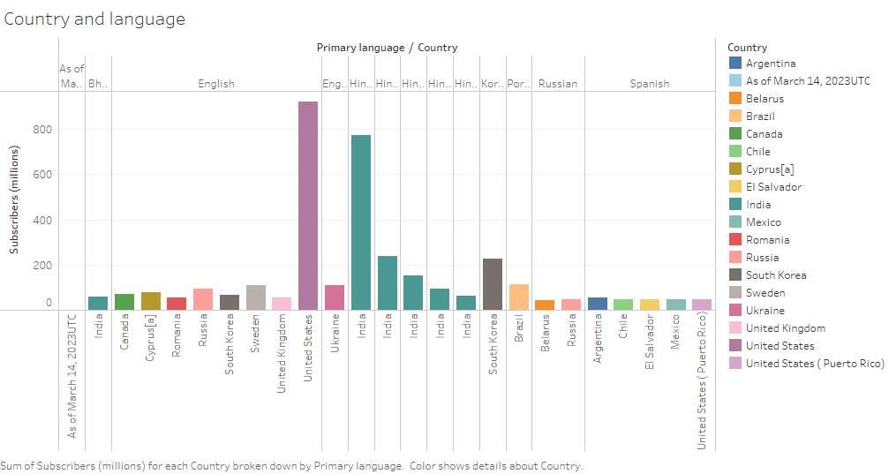

Slide 16
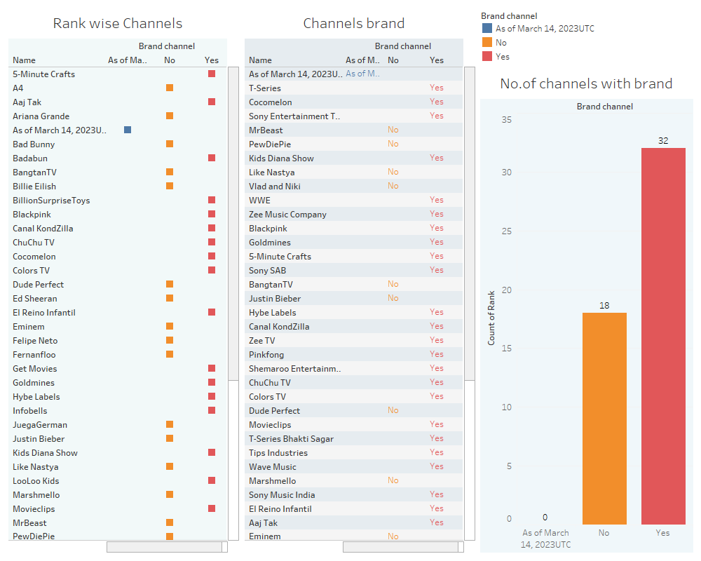

Slide 17
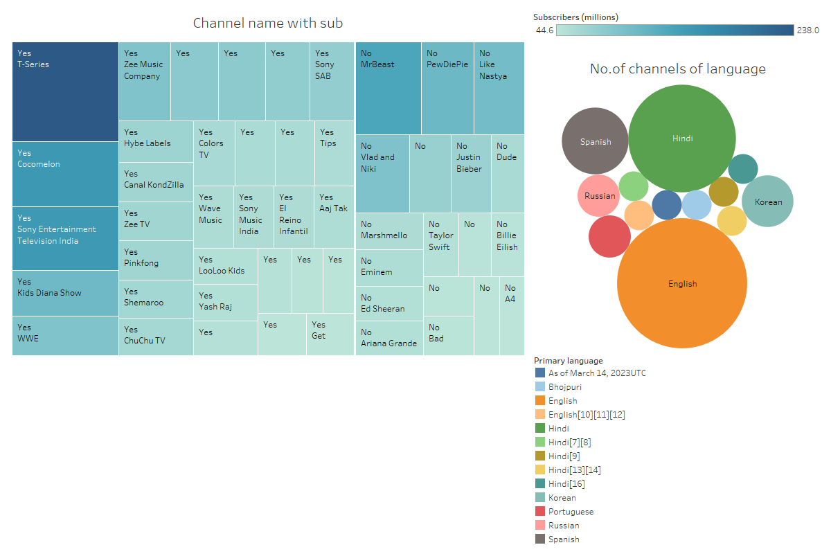

Slide 18
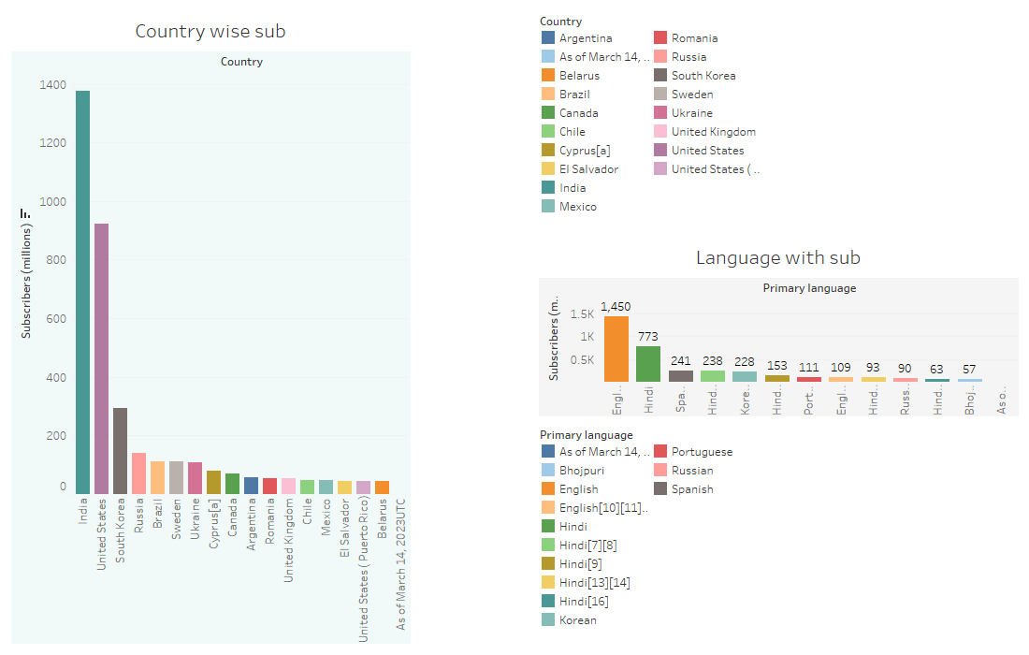

Slide 19
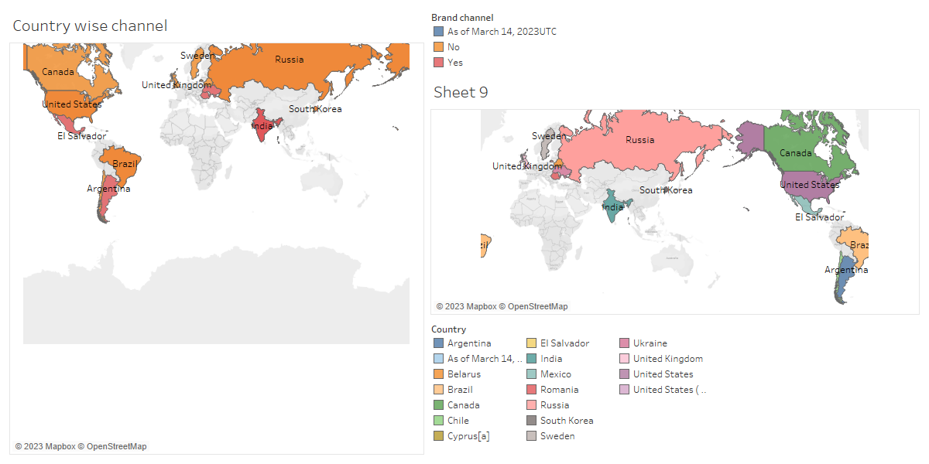

Slide 20
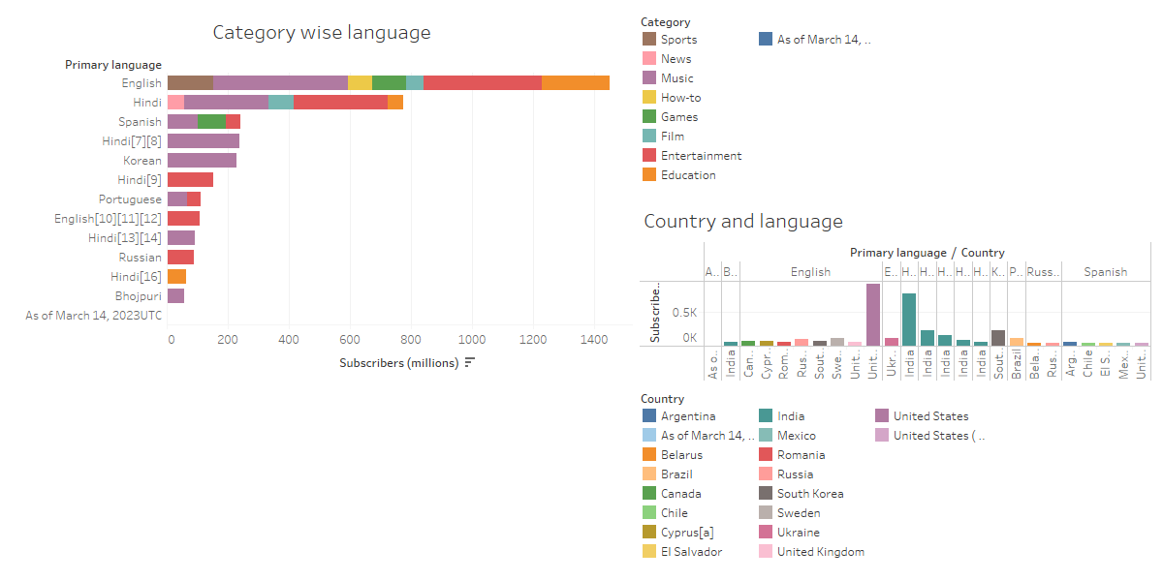

Slide 21
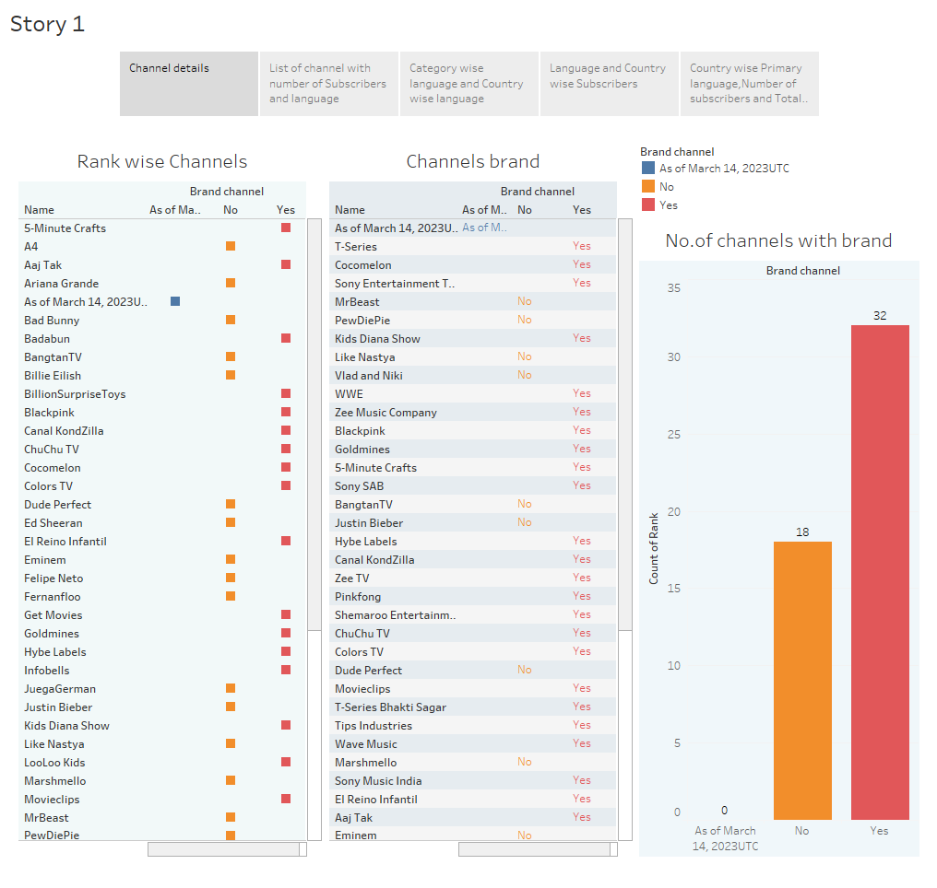

Slide 22
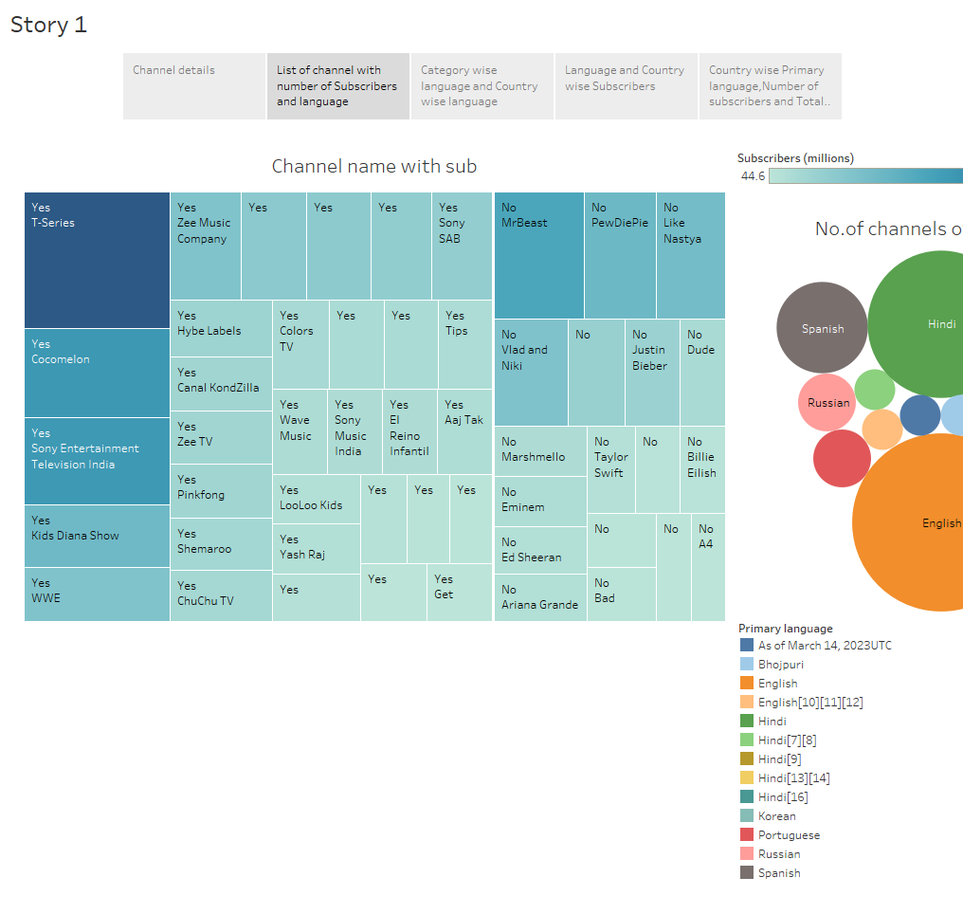

Slide 23
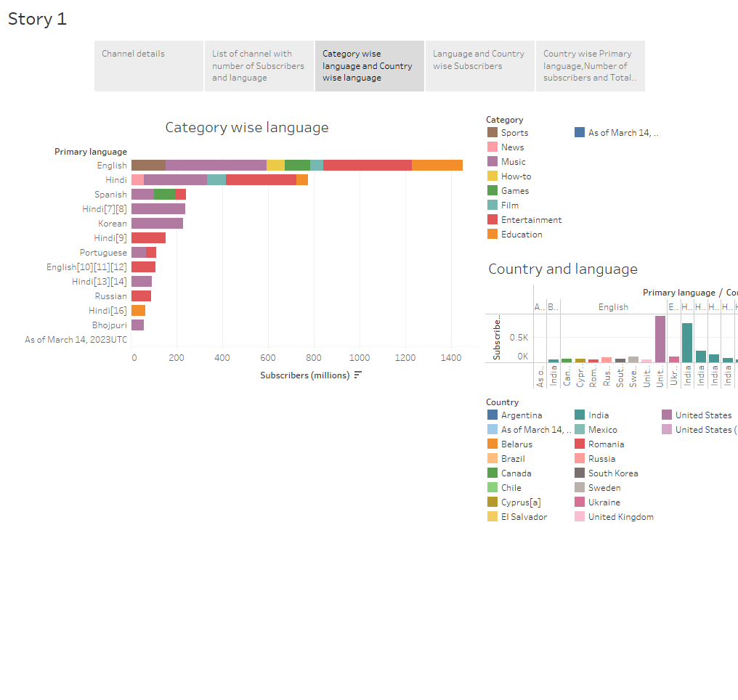

Slide 24
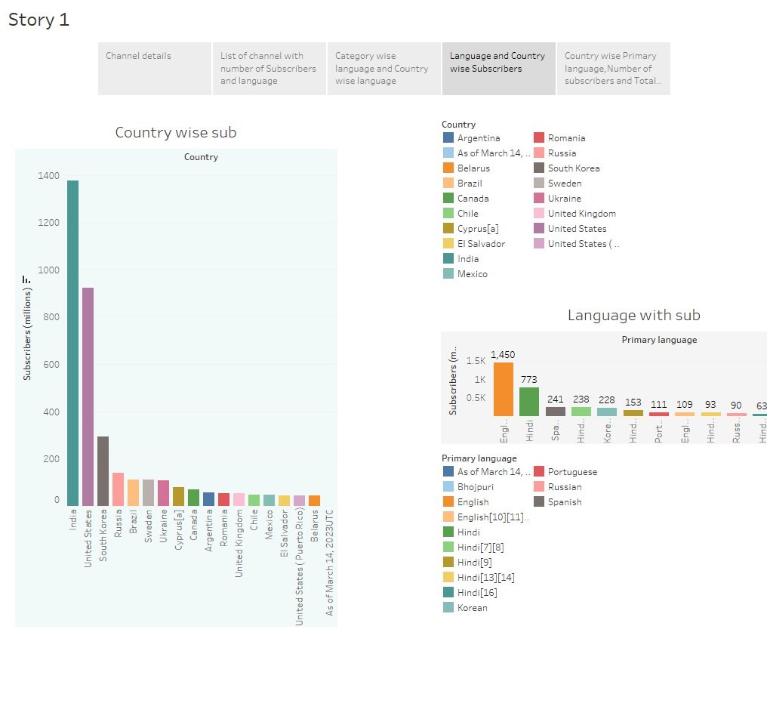

Slide 25
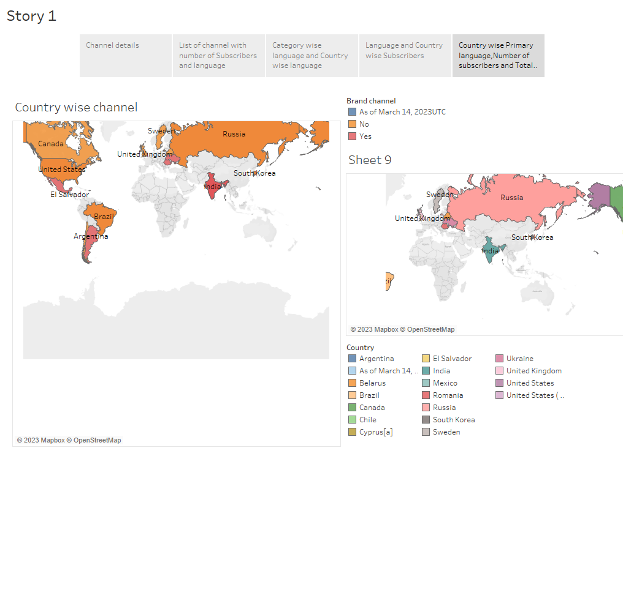

Slide 26
Thank you

